Slide 2
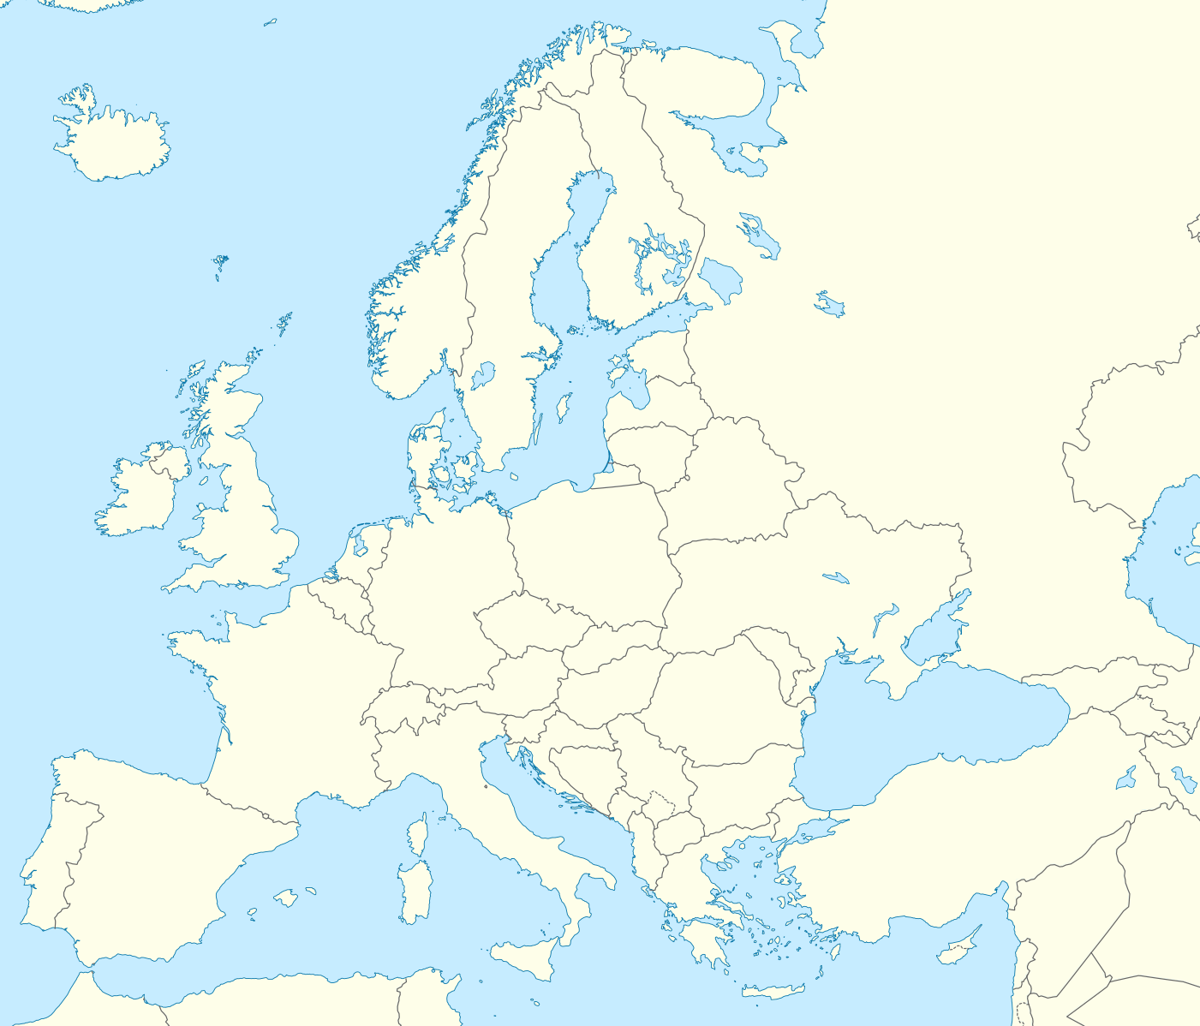
DISAGREEMENT

Slide 3
DISAGREEMENT
Acts 15:36 – 16:5
Some time later Paul said to Barnabas, “Let us go back and visit the believers in all the towns where we preached the word of the Lord and see how they are doing.” Barnabas wanted to take John, also called Mark, with them, but Paul did not think it wise to take him, because he had deserted them in Pamphylia and had not continued with them in the work. They had such a sharp

Slide 4
DISAGREEMENT
disagreement, that they parted company. Barnabas took Mark and sailed for Cyprus, but Paul chose Silas and left, commended by the believers to the grace of the Lord. He went through Syria and Cilicia, strengthening the churches. ​ Paul came to Derbe and then to Lystra, where a disciple named Timothy lived, whose mother was Jewish and a believer but whose father was a Greek. The believers at Lystra and Iconium

Slide 5
DISAGREEMENT
spoke well of him. Paul wanted to take him along on the journey, so he circumcised him because of the Jews who lived in that area, for they all knew that his father was a Greek. As they travelled from town to town, they delivered the decisions reached by the apostles and elders in Jerusalem for the people to obey. So the churches were strengthened in the faith and grew daily in numbers.

Slide 6
DISAGREEMENT
Who is John Mark?
Acts 12:25
When Barnabas and Saul had finished their mission, they returned from Jerusalem, taking with them John, also called Mark.
Acts 12:12
When this had dawned on him, he went to the house of Mary the mother of John, also called Mark, where many people had gathered and were praying.
Colossians 4:10
My fellow prisoner Aristarchus sends you his greetings, as does Mark, the cousin of Barnabas. (You have received instructions about him; if he comes to you, welcome him.)

Slide 7
DISAGREEMENT
Acts 13:4 – 6 & 13
The two of them, sent on their way by the Holy Spirit, went down to Seleucia and sailed from there to Cyprus. When they arrived at Salamis, they (Paul and Barnabas) proclaimed the word of God in the Jewish synagogues. John was with them as their helper. They travelled through the whole island until they came to Paphos...
…From Paphos, Paul and his companions sailed to Perga in Pamphylia, where John left them to return to Jerusalem.

Slide 8
DISAGREEMENT
What is Your Greatest Strength?

Slide 9
DISAGREEMENT
Galatians 2:11-16
When Cephas came to Antioch, I opposed him to his face, because he stood condemned. For before certain men came from James, he used to eat with the Gentiles. But when they arrived, he began to draw back and separate himself from the Gentiles because he was afraid of those who belonged to the circumcision group. The other Jews joined him in his hypocrisy, so that

Slide 10
DISAGREEMENT
by their hypocrisy even Barnabas was led astray. When I saw that they were not acting in line with the truth of the gospel, I said to Cephas in front of them all, “You are a Jew, yet you live like a Gentile and not like a Jew. How is it, then, that you force Gentiles to follow Jewish customs? “We who are Jews by birth and not sinful Gentiles know that a person is not justified by the works of the law,

Slide 11
DISAGREEMENT
but by faith in Jesus Christ. So we, too, have put our faith in Christ Jesus that we may be justified by faith in Christ and not by the works of the law, because by the works of the law no one will be justified.

Slide 12
DISAGREEMENT
What is Your Greatest Strength?

Slide 13
DISAGREEMENT
Where are you weak?

Slide 15
DISAGREEMENT
By loving those who are different, broken, weak. We are that City on the Hill

Slide 16
DISAGREEMENT
Your Sin Will Never Stop The Kingdom of God From Advancing!

Slide 17
DISAGREEMENT
Acts 16:5
So the churches were strengthened in the faith and grew daily in numbers.

Slide 18
DISAGREEMENT
“God, take my life. The good, the bad, the ugly and beautiful, use it as only You can. For the building of Your Church and the glory of Your name.”

